Slide 1
“All that is necessary for the triumph of evil is that good men do nothing.”
- quote usually attributed to Edmund Burke,
18C Irish philosopher

Slide 2
“…do nothing…” Appeasement: giving in to an aggressor to avoid war.

Slide 3
Timeline: Appeasement 1935: Hitler rebuilds the German army. This is clearly in violation of the Versailles Treaty signed after World War I.

Slide 4
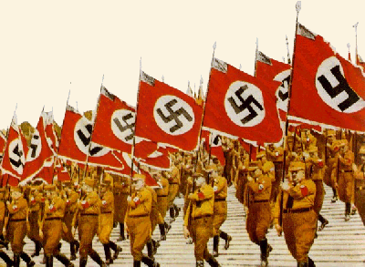
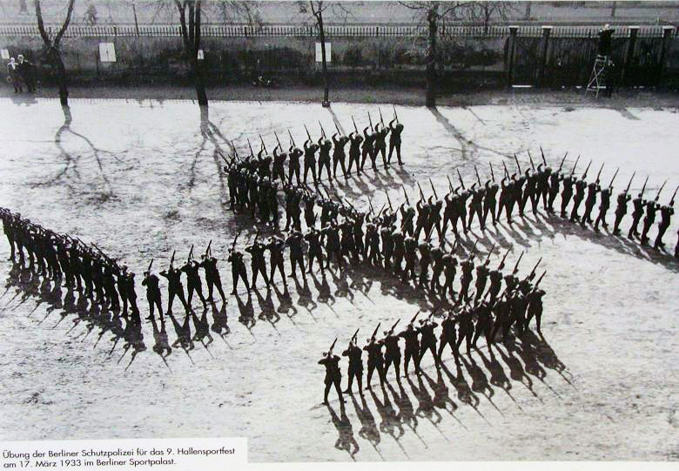

Slide 5
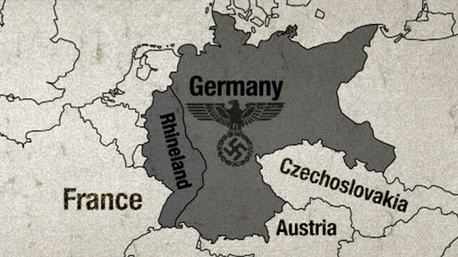
Appeasement 1936: Hitler takes control of the Rhineland and begins to rebuild the industry there. This is also a violation of the Versailles Treaty.
The Rhineland was a demilitarized zone – meant to buffer France from Germany. It is also a heavily industrialized area…good for military hardware production.

Slide 6
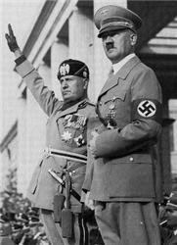
Appeasement 1936: Rome-Berlin Axis created.

Slide 7
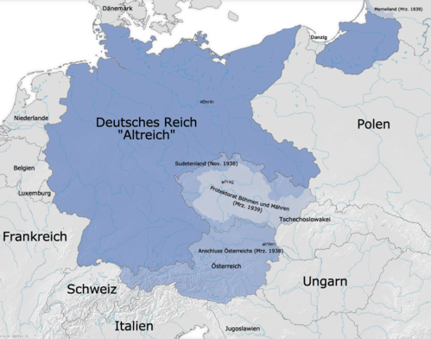
Appeasement 1938: The Anschluss*: Hitler sends troops into Austria to “reunify the German people.”
*Connection/
annexation

Slide 8
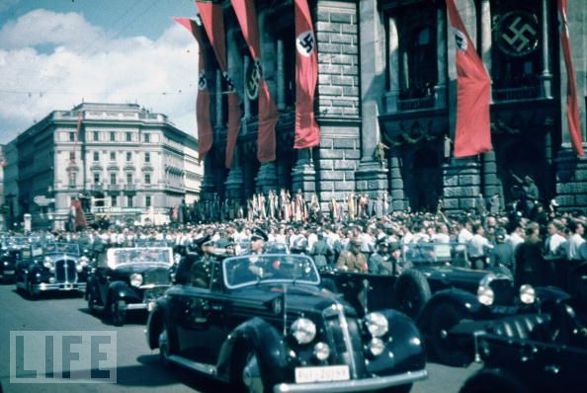
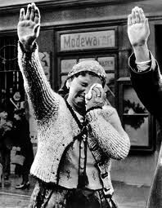
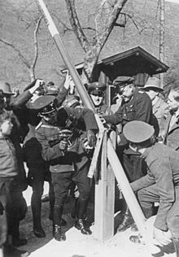
http://www.youtube.com/watch?v=QA6QBObI6Po&feature=related

Slide 9
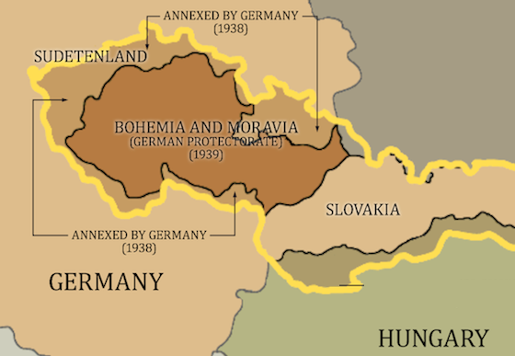
Appeasement 1938: Hitler annexes the Sudetenland from Czechoslovakia. The Sudetenland, filled with ethnic Germans, is a heavy industrial region with many fortifications in the event of conflict. Many Sudeten Germans welcomed annexation by Germany.
Germany was taking lands and re-arming! It must be time to…

Slide 10
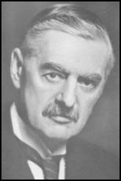
…talk!
Neville Chamberlain was the British Prime Minister between 1937 and 1940.
Like many in Britain who had lived through World War I, Chamberlain was determined to avoid another war.
He traveled to Munich for talks with Hitler in 1938 and signed an treaty with Adolf Hitler: Britain and France accepted that the Czech region called the Sudetenland should be ceded to Germany.
Historically, he is most-remembered for the policy of appeasement.

Slide 11
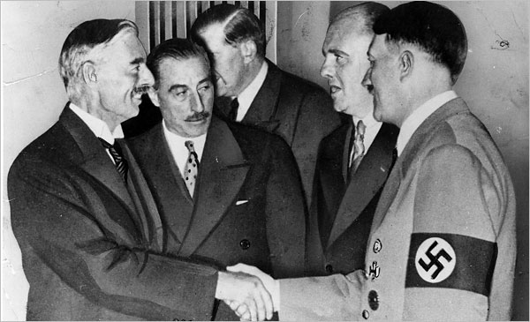
The Munich Conference:
Hitler meets with Chamberlain.
Consider: what were their motivations?

Slide 12
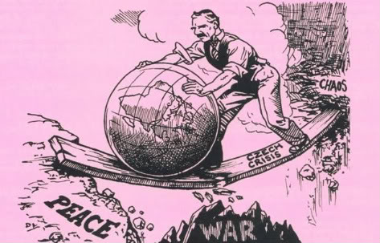
Appeasement
Munich Agreement
the physical annexation by Germany of the Sudetenland.
this had military consequences for Czechoslovakia, as most of its factories and defensive fortifications were located there. Czechoslovakia was defenseless.

Slide 13
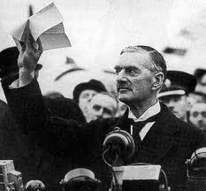
“Peace in our time”
Neville Chamberlain, September 1938
http://www.youtube.com/watch?v=Skvw5BqTEO0

Slide 14
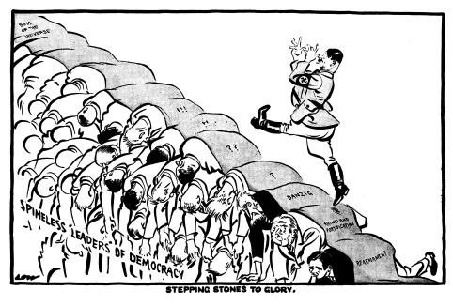

Slide 15
One man made his views on appeasement clear: "You were given the choice between war and dishonor. You chose dishonor…
…and you will have war."

Slide 16
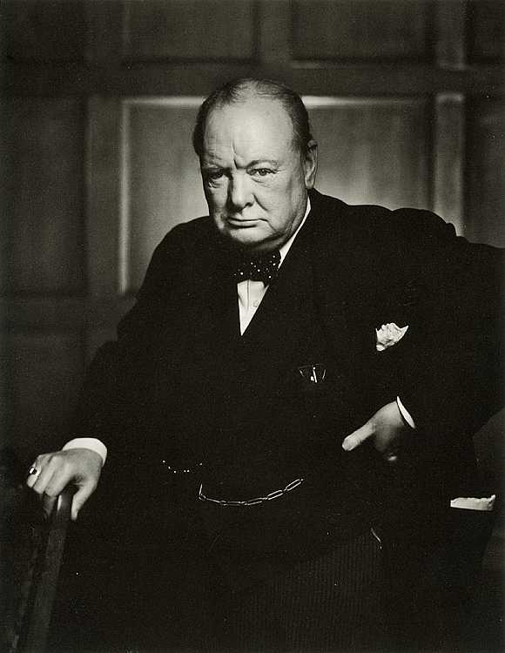
Winston Churchill, in the British government at the time, warned the free world about appeasing Hitler.
He warned against German rearmament.
He was an optimist and inspiring speaker.
He would serve as Prime Minister during WW2, and lead Britain through it’s darkest hours.
“An appeaser is one who feeds a crocodile, hoping it will eat him last.”
Winston Churchill
Germany Gets Aggressive
http://www.history.com/topics/adolf-hitler/interactives/inside-wwii-interactive

