Slide 1
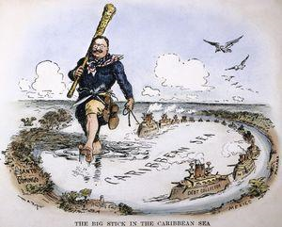
Roosevelt’s Foreign Policy
Roosevelt promoted a strong military to achieve America’s goals
“Big Stick” diplomacy
  “Speak softly and carry a big stick”
    U.S. must create and use, when necessary, a strong military to achieve America’s goals.
Roosevelt Corollary
  Updated the Monroe Doctrine by continuing the belief that Europe should stay out of the Western hemisphere by adding that the U.S. would police Latin America and keep order

Slide 2
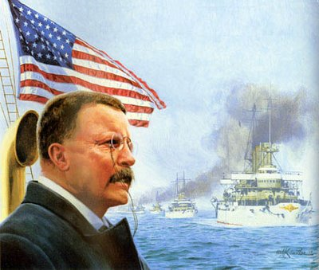
Great White Fleet
Meanwhile, President Roosevelt saw the need to continue to build up the U.S. Navy to protect U.S. interests in Asia.
Won congressional support to build a new force of navy ships called the “Great White Fleet”.
  16 white battleships sent on a “good will cruise” around the world.
  Demonstrated U.S. increased military power to the world

Slide 3
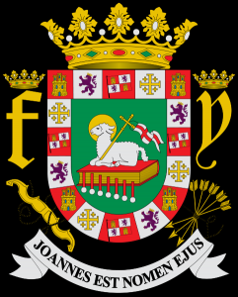
U.S. Policy in Puerto Rico
Puerto Rico remained under direct control of the U.S. after the Spanish-American War.
The Foraker Act established a civil government in PR.
Many Puerto Ricans did not have the same citizenship rights as U.S. Citizens
Today it is a commonwealth

Slide 4
The Panama Canal
Roosevelt decided the US would purchase the rights to construct a canal across the area known as Panama.
Problem: Panama was a part of Colombia.
TR offered Colombia $10 million, + yearly rent of $250,000 in exchange for control of the Canal Zone.
Colombia said no and demanded more $.
America encouraged Panama to revolt and sent a battleship, the USS Nashville, to help “convince” Colombia to let Panama go and to try to get a better price.
The U.S. paid Panama $10 million to build the canal

Slide 5
The Panama Canal
Construction of the canal took 10 years (to go nine miles).
Tropical diseases (malaria and yellow fever) killed thousands of workers.
It was a triumph of human engineering.
  only time in the history of a government project
    finished early (6 months) and under budget ($23 million).
    NY to San Francisco was now 6100 miles, cutting 8,000 miles off the trip.
    Connected the Atlantic and Pacific Ocean

Slide 6
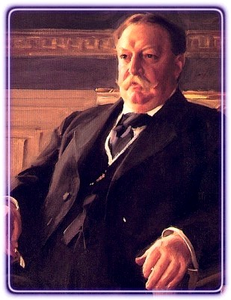
Dollar Diplomacy
After Roosevelt’s presidency ended, William Howard Taft was elected
Taft’s policy vs. Roosevelt’s
He hoped to rely less on the “big stick” and more on “dollar diplomacy”
  Aimed to increase American investments in businesses and banks throughout Central America & the Caribbean.
William Howard Taft

Slide 7
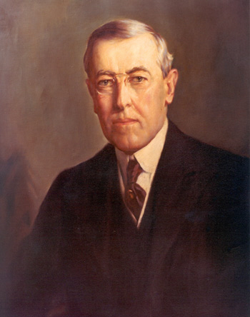
Moral Diplomacy
1912- Woodrow Wilson won the Presidency.
Wilson’s foreign policy
“Moral Diplomacy”
  The U.S. would not use force to assert influence in the world, but would instead work to promote human rights.
  Only use military force if absolutely necessary
  As a result, American imperialism decreased.
Woodrow Wilson

Slide 8

Pancho Villa
Link to information about Pancho Villa
Pancho Villa Death Mask Video

