Slide 1
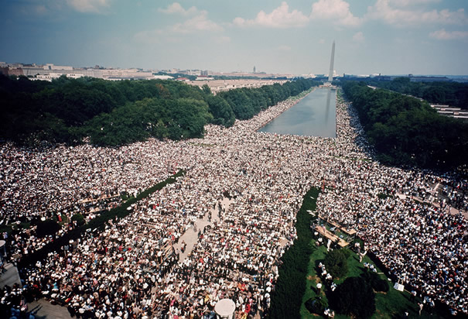
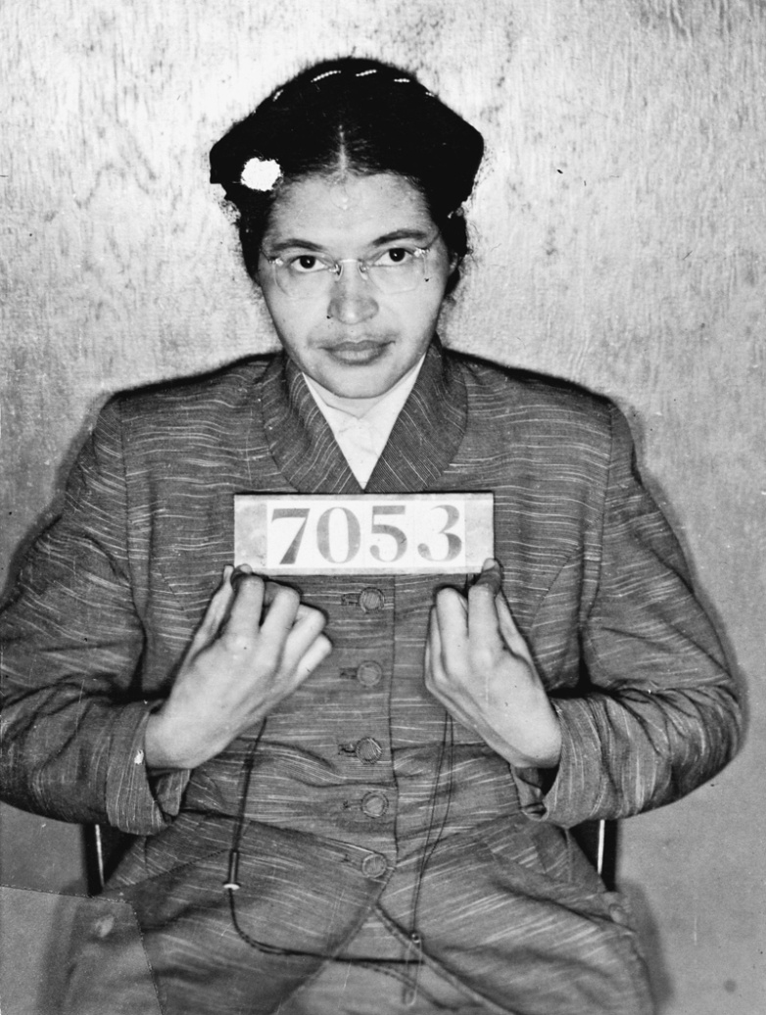
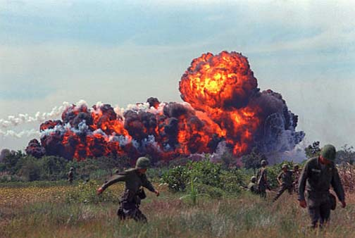
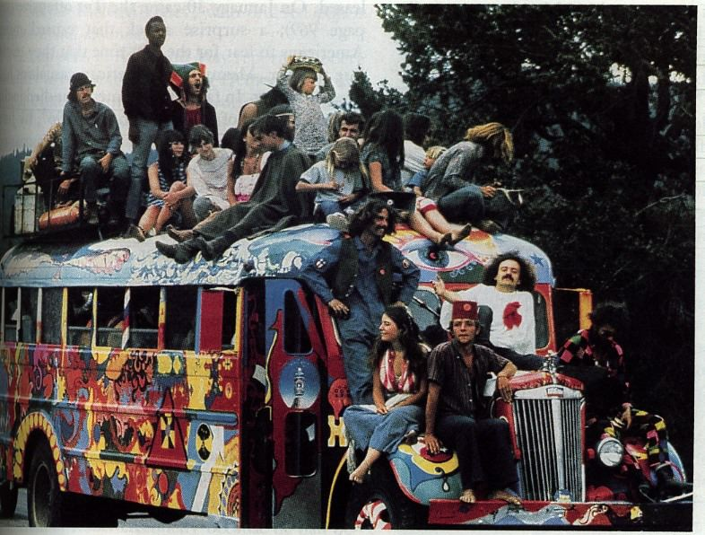
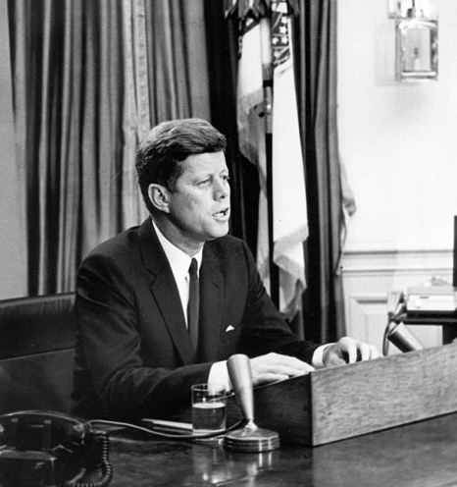
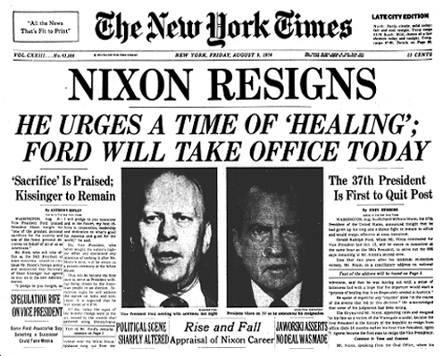
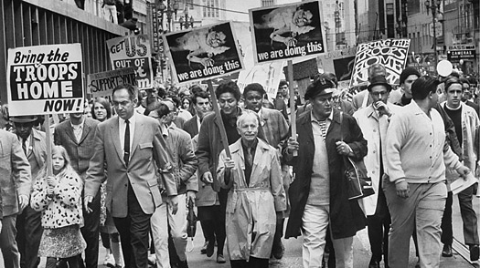
Unit 7: Crisis and Change (1945-1980)

Slide 2
The Civil Rights Movement

Slide 3
Segregation
De jure segregation: imposed by law
Ex. Jim Crow laws, “Separate but equal:” black & white facilities as long as they were ‘equal’
De facto segregation: by unwritten custom/tradition, it’s a fact of life
Ex. Housing discrimination, African Americans only hired for low paying jobs
Impact of discrimination: high rates of poverty & illiteracy, lower rates of home ownership & life expectancy, couldn’t vote in the South, didn’t hold public office in the North

Slide 4
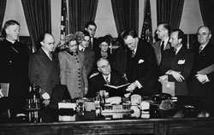
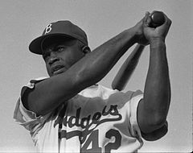
Early Civil Rights
In the ‘40s CORE (Congress of Racial Equality) organized non-violent protests in northern cities
‘47 Jackie Robinson became the first African-American to play major league baseball
‘48 President Truman gave an executive order to desegregate the military

Slide 5
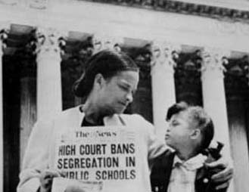
Brown v. Board of Education (1954)
Supreme Court overturned Plessy v. Ferguson & ruled that “separate but equal” was unequal
All 9 justices agreed (unanimous)
Brown II: the states were instructed to integrate schools “with all deliberate speed”
“The Southern Manifesto” (1956) 100 Congressmen pledged to legally oppose the Brown ruling
KKK revived & prominent whites joined “White Citizens Councils” that opposed integration
Used economic & political pressure against those who supported integration
Ex. Boycotts, firing employees, evicting tenants, denying loans

Slide 6
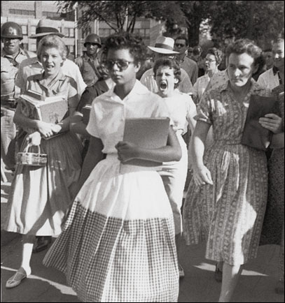
Federal & state governments clash
Little Rock Nine (1957)
Arkansas governor used the state National Guard to lock out 9 black students from Central High
Though Eisenhower had doubts about integration, he did take a stand at states violating the Court’s decision
The students were escorted to school by federal troops every day for a year
Civil Rights Act of 1957:
Established a commission to investigate civil right violations & gave Attorney General power to protect voting rights
Weak enforcement, but it was the first Civil Rights law since Reconstruction

Slide 7
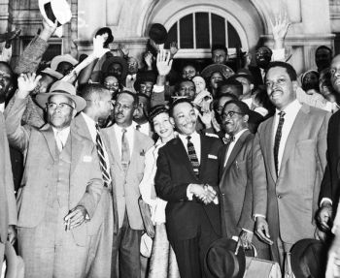
Montgomery Bus Boycott
1955 Rosa Parks was arrested for refusing to give her seat up when the bus driver requested she give it to a white passenger
Parks was a seamstress & the secretary of the Montgomery NAACP
African-Americans began a year-long boycott of public transportation
Martin Luther King Jr., a Baptist minister, urged non-violent protest & boycotters chose him as a leader
Supreme Court ruled the city law unconstitutional in 1956
King founded the Southern Christian Leadership Conference to continue the struggle

Slide 8
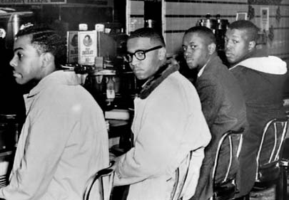
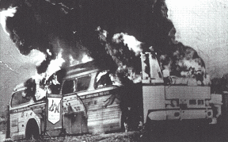
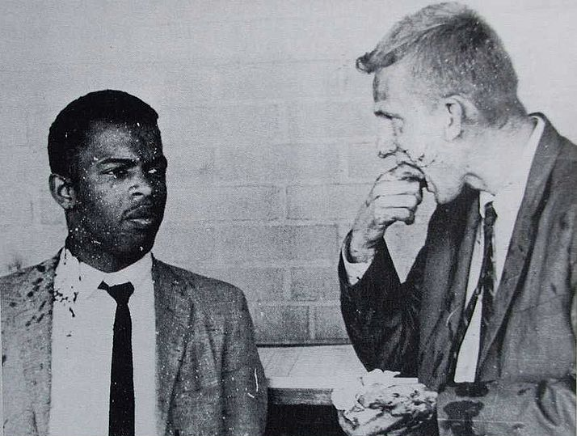
Sit-ins
Freedom Riders
1960 Greensboro Four sat at a Woolworth’s lunch counter after they are refused service
Lots of news coverage, many others participate in sit-ins, wade-ins and read-ins
Student Nonviolent Coordinating Committee (SNCC) was founded
CORE had riders take public buses from Washington D.C. bound for New Orleans
Along the way the riders broke segregation laws
In AL the busses were fire-bombed & attacked by a mob
Pres. Kennedy made a deal with MS: police protected riders, interstate transportation was desegregated, but the riders were arrested for disturbing the peace

Slide 9
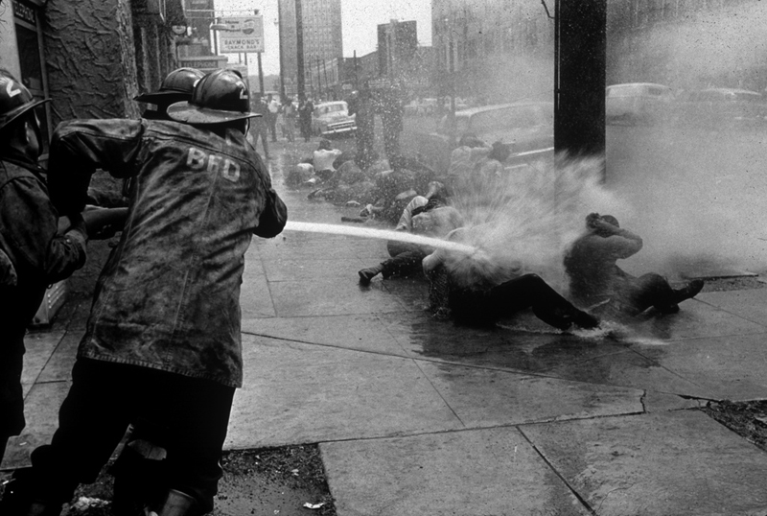
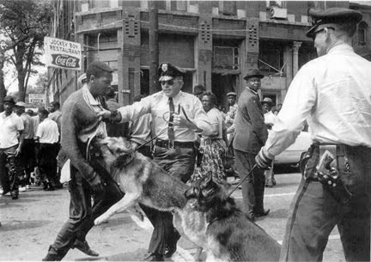
Birmingham Campaign
Spring of ‘63 SCLC targeted Birmingham, AL for a civil rights campaign
King participated & was arrested
Government used police dogs and fire hoses on the non-violent protesters
Drew the attention of many Americans

Slide 10
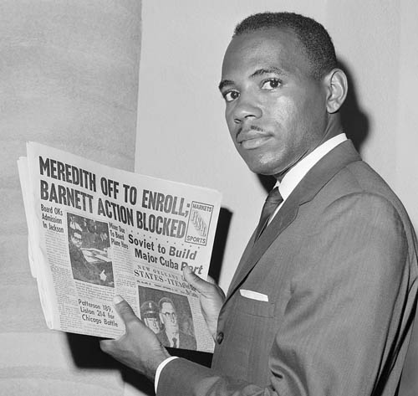
Confrontations Intensify
James Meredith (Air Force veteran) enrolled in the University of Mississippi “Ole Miss”
Miss. Governor refused to integrate, but Federal Courts ruled to desegregate
Full scale riot when Meredith arrived on campus
JFK gave a moving civil rights speech June 11, 1963
He said the issue of segregation is a moral one of freedom and equality
http://www.youtube.com/watch?v=rS4Qw4lIckg

Slide 11
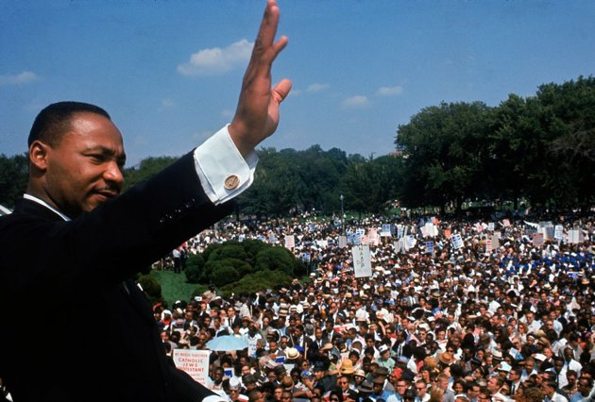
March on Washington
Washington, D.C., Aug. 28th 1963 over 200,000 attend
Organized by civil rights, labor, and religious organizations, under the theme "jobs, and freedom,” called for civil & economic rights for African Americans.
MLKJ delivered his "I Have a Dream" speech advocating racial harmony
Helped pass Civil Rights Act (1964) and Voting Rights Act (1965).

Slide 12
Civil Rights Act of 1964
After JFK’s assassination, Pres. Johnson put his full support behind the civil rights act
“No eulogy could more eloquently honor President Kennedy’s memory…than the earliest passage of the civil rights bill for which he fought so long.”
Passed in the House, but was filibustered for 60 work days before it passed the Senate
Banned segregation in public accommodations
Gave feds power to compel states to desegregate schools
Justice Dept. could prosecute those who violated people’s civil rights
Outlawed employment discrimination based on race, sex or national origin

Slide 13
Push for Voting Rights
SNCC (Student Nonviolent Coordinating Committee) registered black voters during “Freedom Summer” in 1964
24th amendment: banned the poll tax (1964)
March on Selma (1965): MLKJ & SCLC campaigned for voting rights legislation despite armed troops attacking as they crossed Edmund Pettus Bridge on “Bloody Sunday”
Voting Rights Act (1965) banned literacy tests & allowed federal oversight of elections for states that had a history of discriminating against minorities
1964: 7% African Americans registered; 1986: 70%

Slide 14
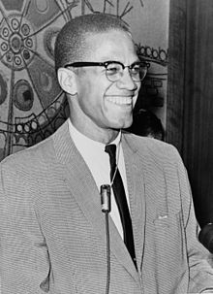
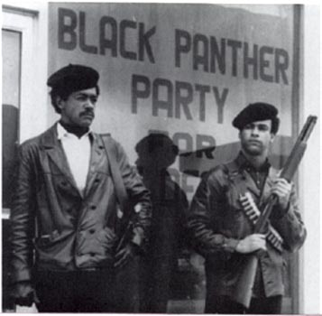
African American radicals & militants
Malcolm X (Little): controversial civil rights activist
As a member of Nation of Islam preached black supremacy, segregation & violence
After he left it, disavowed racism spoke more of working together with civil rights leaders
Assassinated shortly after he left by members of the Nation of Islam
“Black Power:” coined by Stokely Carmichael
Black people should use economic & political muscle to gain equality
But becomes connected to black violence by some
Black Panthers: founded in CA, armed patrol of black neighborhoods & anti-poverty programs

Slide 15
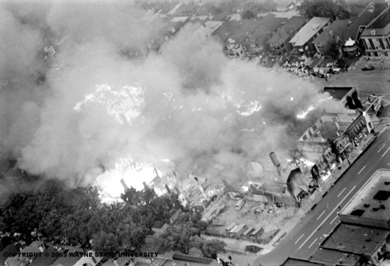
Violence
Worst race riots in American history erupted after the Act in Watts, Los Angeles
In 1967, even worse violence happens in Newark, NJ and Detroit, MI
Pres. Johnson had the Kerner Commission investigate the cause of the violence (long-term racial discrimination)
While involved in planning a “Poor People’s Campaign” MLKJ was assassinated April 4, 1968

Slide 16
Women’s voices
NOW (National Organization for Women)
Founded by Friedan; lobbied for equal treatment for women though legislation/court cases
Supported Equal Rights Amendment (ERA) & reproductive rights
ERA: failed amendment to outlaw gender discrimination
Feminist Gloria Steinem tried to change attitudes through mass media (writer & co-founder of the magazine Ms.)
Some, like Phyllis Schlafly opposed the ERA and feminist movement, saying it attacked families & nature

Slide 17
Legal gains
Title VII of the Civil Rights Act of 1964 outlawed discrimination based on sex
Equal Employment Opportunity Commission to investigate
Title IX of the Higher Education Act of 1972 banned discrimination based on sex in education
Equal Credit Act (1974): can’t deny credit based on sex
Roe v. Wade: legal right to abortion

Slide 18
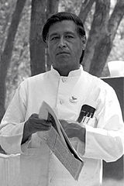
Latino Rights
While many Spanish speakers already lived in the Southwest, many others migrated in the mid-1900s
Puerto Ricans, Dominicans & Cubans came to the urban areas on east coasts
Largest group was Mexican (braceros)
Discrimination in employment, education etc.
Cesar Chavez: Latino rights activist, fought for migrant farmworkers
United Farm Workers used non-violent tactics
Chicano movement: focused on Mexican-American history & culture, addressed issues: poverty, discrimination, jobs & opportunity

Slide 19
Native American Rights
American Indian Movement (AIM)
Organized to fight for Native American civil rights
land, legal rights, self-government
1969 a group of 100 Native Americans occupied Alcatraz
According to a Federal treaty unoccupied Federal land was granted to Natives
Stayed until mid-1971 despite the Coast Guard trying to remove
“Long March” from San Francisco to D.C. in 1972
Occupied the BIA headquarters
1973 occupied Wounded Knee
Demanded investigation into reservation conditions
Indian Self-Determination Act of 1975: greater control of resources and education on reservations

Slide 20
Consumers & people with Disabilities
Ralph Nader wrote Unsafe and Any Speed
National Traffic and Motor Vehicle Safety Act of 1966
Seatbelts became standard equipment in cars
Occupational Safety and Heath Administration (OSHA)
Workplace safety regulations
Government passed laws guaranteeing equal access to education for people with disabilities
Architectural Barriers Act (1968): federally constructed buildings accessible to people with physical disabilities.
Rehabilitation Act (1973): Sections 501, 503, and 504 prohibited discrimination in all programs or services receiving federal funds

Slide 21
Environmental Movement
Rachel Carson’s Silent Spring (1962) described the terrible effect of pesticides on animals (banned DDT)
1969 Cuyahoga River in Cleveland, OH caught FIRE when a spark ignited floating oil & debris
April 22, 1970 20 million Americans participated in a nation-wide protest: Earth Day
Attracted support from Civil Rights, Women’s Rights, Sierra Club & Wilderness Society

Slide 22
Environmental Movement
1970, Nixon created Environmental Protection Agency (EPA)
Clean up & protect environment
Limit or eliminate pollutants that pose a public health risk
Environmental law: Clear Air Act (1970), Clean Water Act (1971), Endangered Species Act (1973), Nuclear Regulatory Commission (1974)
Environmental crises:
Love Canal: neighborhood built on toxic waste dumping ground causes birth defects & cancer
Superfund created to clean up contaminated sites
Three Mile Island (1979): core of a nuclear reactor started melting (contained)
Opposition to regulation grew
Some thought it was too much government involvement
Stripped private property owners or rights, regulation would hamper business, divert money to clean-up

