Slide 1
The Emergence of the Political Machine
Political machine was an organized group that controlled the activities of a political party in a city and offered services to voters and businesses in exchange for political or financial support.

Slide 2
Organization of the machine
Machine was run by a “boss”
It was like a pyramid
At the top was the city boss who controlled jobs in police, fire, and sanitation, and controlled the city government.
They tried to help immigrant problems and so won immigrant votes and loyalty.

Slide 3
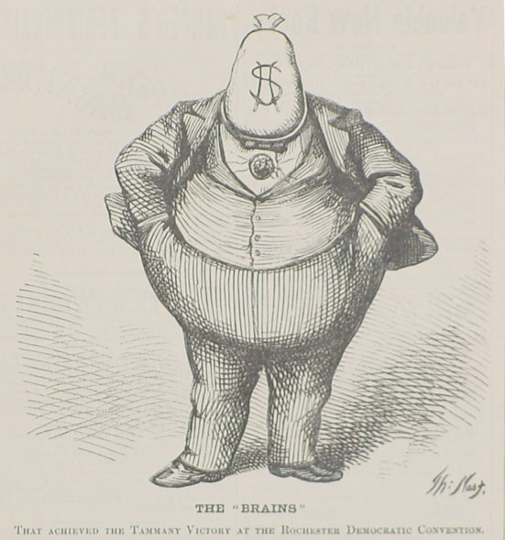
Corruption
It was like the mob
You had to go through the boss to get things in a city: new businesses, licenses, inspections, money for schools, hospitals, etc.
The machine then got paid for providing these governmental services

Slide 4
More corruption
To keep the machine running they falsified elections
Put in names of dog, children, and dead people
Had more votes than registered voters
Used “kickbacks”
Machine would choose a worker that contracted for a government job, the worker would charge more than necessary and kick back a fee to the political machine

Slide 5
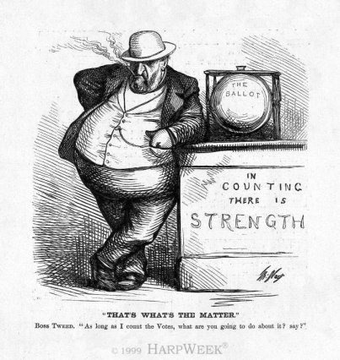

Slide 6
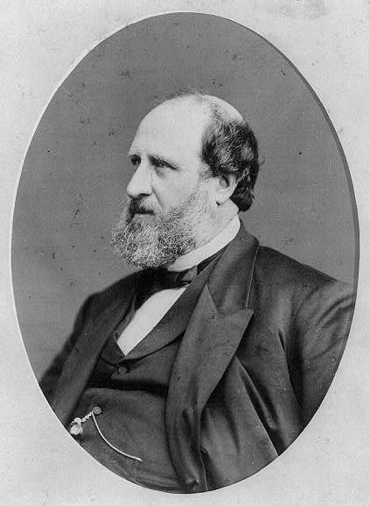
Boss Tweed
William “Boss” Tweed became one of the most powerful bosses
He headed Tammany Hall (Democratic Party) in New York
Tweed ring pocketed $200 million from the city in kickbacks and payoffs
Newspapers and cartoonists attacked him
Finally arrested and died in jail

