Slide 1
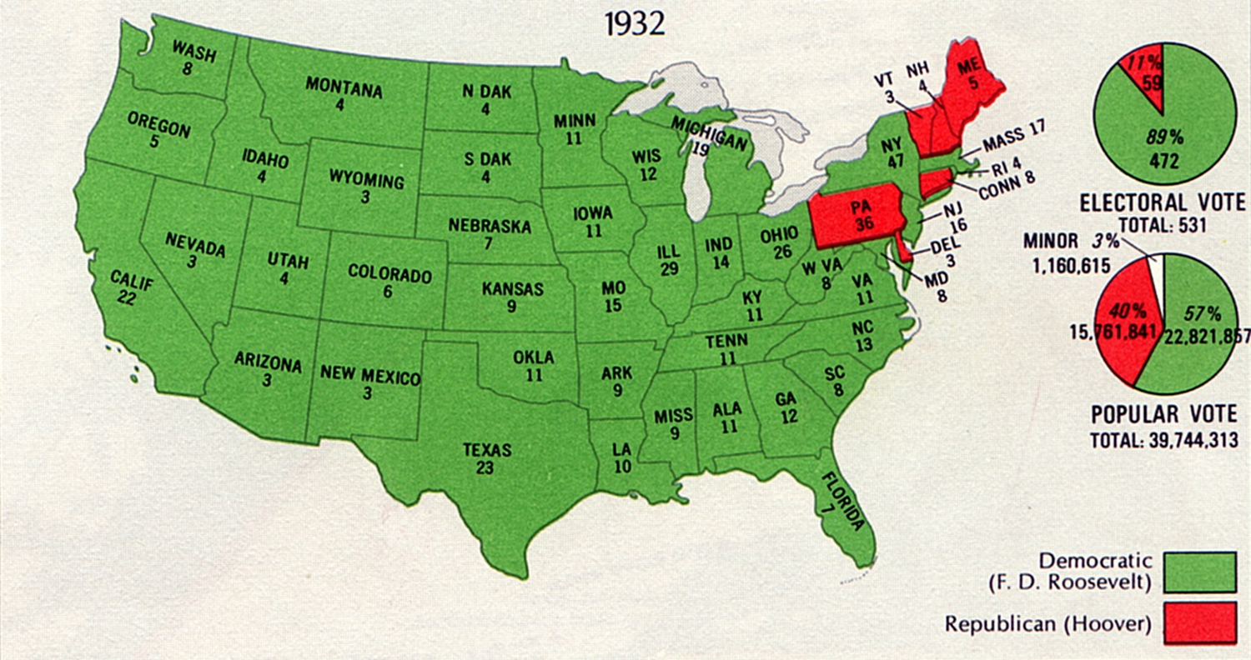

Slide 2
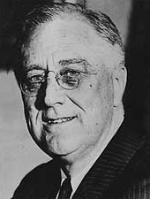
Franklin D. Roosevelt
When he was inaugurated, unemployment had increased by 7 million.
Poor sections (like Harlem) had 50% of the population unemployed
Instated his plan to help the Depression known as the “New Deal”

Slide 3
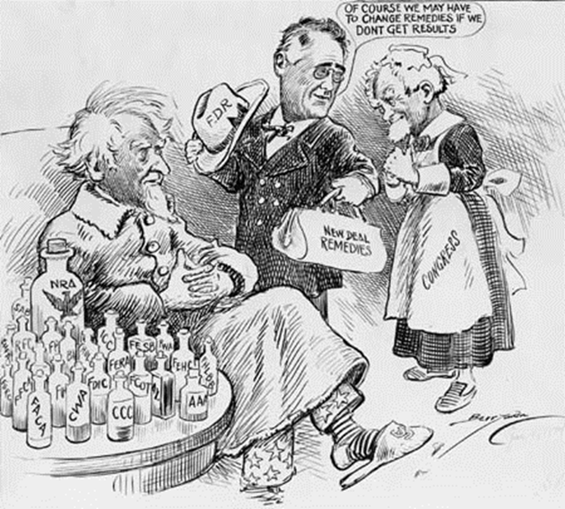
The New Deal
Relief: to provide jobs for the unemployed and to protect farmers from foreclosure
Recovery: to get the economy back into high gear, “priming the pump”
Reform: To regulate banks, to abolish child labor, and to conserve farm lands
Overall objective: to save capitalism

Slide 4
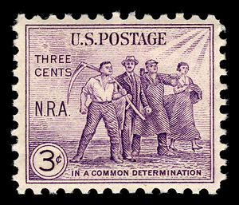
National Recovery Act (NRA)
Purpose: recovery of industry
Created a partnership of business, labor, and government to attack the depression with such measures as price controls, high wages, and codes of fair competition
Anti Laissez-Faire

Slide 5
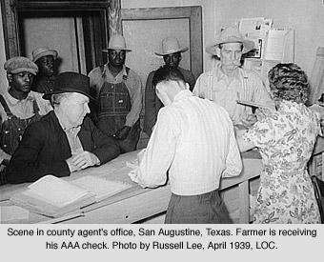
First Agricultural Adjustment Act (AAA)
Purpose: the recovery of agriculture
Paid farmers who agreed to reduce production of basic crops such as cotton, wheat, tobacco, hogs, and corn
Money came from a tax on processors such as flour millers and meat packers who passed the cost on to the consumer

Slide 6
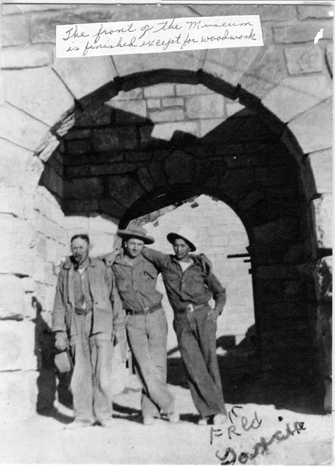
Civilian Conservation Corp (CCC)
Purpose: relief
Gave outdoor work to unemployed men between the ages of 17 and 29
They received $30 per month, but $22 went back to the family

Slide 7
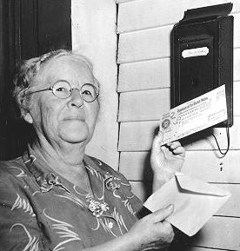
Social Security Act
Purpose: REFORM
Gave money to states for aid to dependent children, established unemployment insurance through payroll deduction, set up old-age pensions for retirees

Slide 8
Anti-New Deal Organization
Conservative opponents to the New Deal had an organization called the American Liberty League. They had money but were small in numbers, so FDR was not worried.
Supreme Court would eventually go on to declare many acts of the New Deal unconstitutional
Too much power to the President

Slide 9
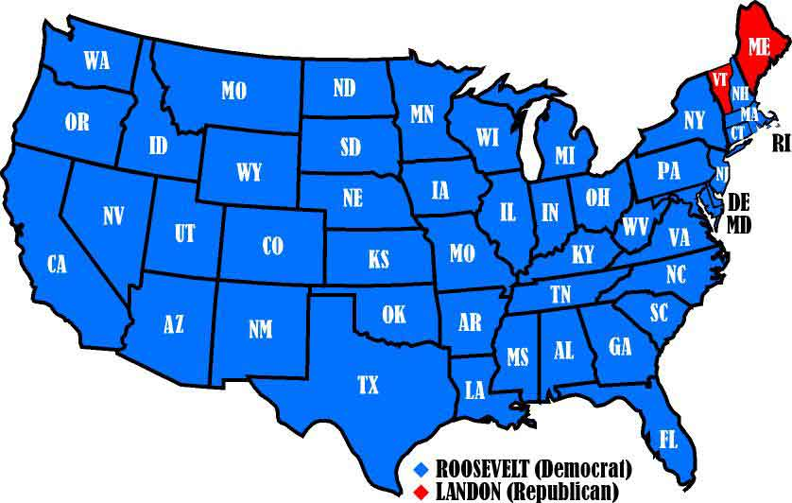
Election of 1936

Slide 10
