Slide 1
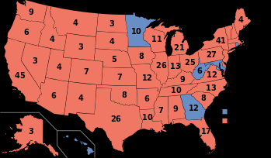
Election of 1980
Ronald Reagan (Rep.) vs. Jimmy Carter ( Dem.)
Landslide Victory!
New Right! – Religiously Tied Republicans

Slide 2
Domestic Policies- Reagan
Reaganomics: (Supply-side Economics)
Large tax cuts, Gov. de-regulation, smaller government, interventionism- U.S to be involved all over the world
Trickle-Down Theory: want the economy to improve you need to start at the top “technically worked”
Arthur- Laffer- Laffer Curve
economic theory tax cuts could improve economy
Savings & Loan Crisis:
Banks lend too much money for houses, gov. has to bailout(familiar? )

Slide 3
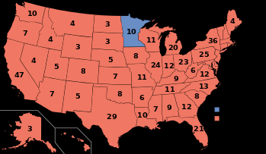
Election of 1984
Ronald Reagan vs. Walter Mondale (Geraldine Ferraro – 1st female to run for executive office )

Slide 4
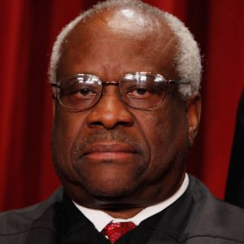
Domestic Policy
Clarence Thomas: an African- American Republican – Thurgood Marshall’s replacement as Supreme Court Justice

Slide 5
Not so Domestic, but Reagan fought Communism…

Slide 6
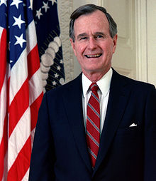
George H.W. Bush (41)
One term
Favored international agendas instead of domestic policies
Clean Air Act Amendments of 1990 (environmentally friendly)

Slide 7
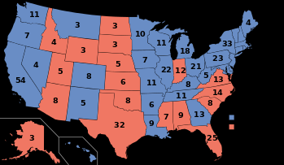
Bush(Rep.) vs. Clinton ( Dem. ) Election of 1992

Slide 8
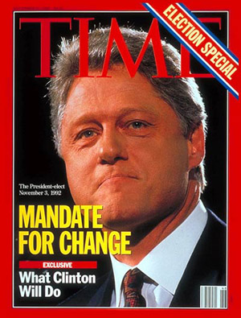
Domestic Policy- Clinton
Shift to social agenda.
-National Health Care Plan
-Family Leave Act
-ADA ( American Disabilities Act)
-Don’t Ask Don’t Tell
-Technology Boom- 1990’s
-Whitewater & Monica Lewinsky
-Brady Bill
- Columbine Shooting
Foreign Policy :
-Somalia- NOT another Vietnam!
-Serbia – Slobodan Milosevic

Slide 9
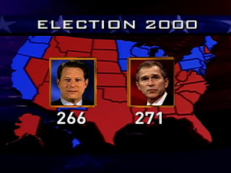
Election of 2000 GW Bush(Rep.) vs. AL Gore ( Dem)

Slide 10
George W. Bush (43) Domestic Policy
“Peace Dividend” – NO MORE deficit
Kyoto Treaty / Protocol- treaty to reduce emissions for a better planet… reduction of Global warming
No Child Left Behind-
effort to make public schools more accountable
Patriot Act –
Freedom of Information?

