Slide 1
Reconstruction Begins

Slide 2
Cost of the War
Union Cost-6.1 Billion, inflation 80%
Confederate Costs- 2 Billion, inflation 9,000
Lands and businesses destroyed
Southern industry crippled
Death tolls total 623,000

Slide 3
Lincoln’s Plan for Reconstruction
Restore the Union quickly and without punishment
Take oath of loyalty and obey federal laws about slavery
High ranking officials and military leaders excluded from law making
1/10th of voters taken oath have election to elect Congressmen

Slide 4
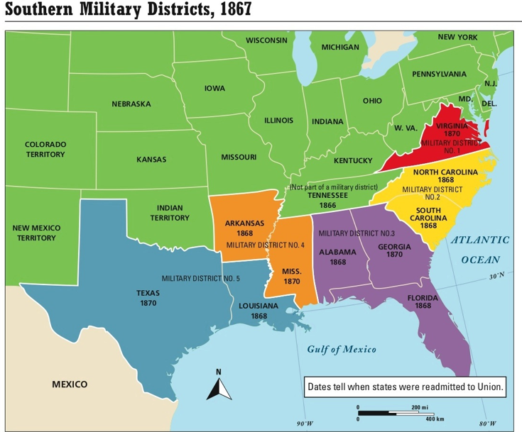

Slide 5
Lincoln Assassinated
Shot by John Wilkes Booth
Killed at Fords Theatre on April 14, 1865
Worked with 9 other men-main: George Azterdot-kill Andrew Johnson, Lewis Powell-SoS William Seward, David Herold-helped escape
Mary Surratt was convicted of being a co-conspirator because of her boarding the men, first woman executed in the US

Slide 6
Presidential (Johnson’s) Reconstruction
Andrew Johnson now president
Amnesty to those who took oath of allegiance
No confederate could be elected
Repeal secession laws
13th amendment must be approved in each state

Slide 7
Radical Republican Plan
Republicans in Congress did not believe South was getting harsh enough treatment
Wanted:
Revenge and punish South for causing the war
Federal government to play key role in transition for the freedman-Found Freedman’s Bureau
Wanted to the keep Republican party power in North and South

