Slide 1
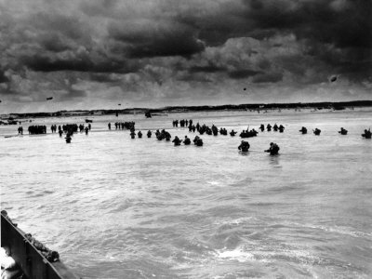
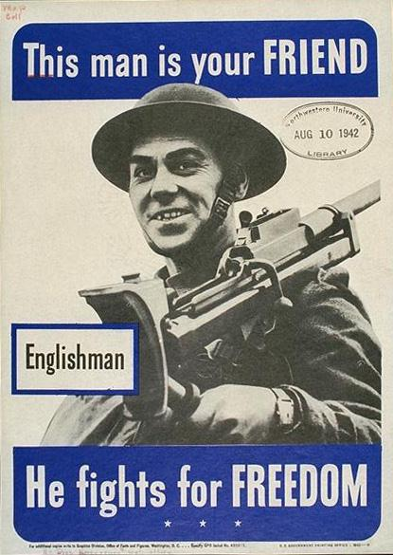
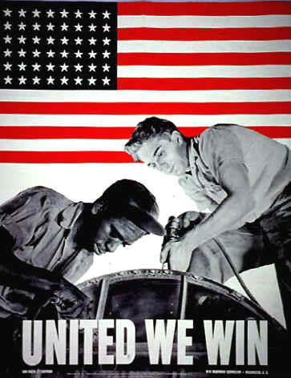
WWII BATTLES
WWII BATTLES

Slide 2
Stalingrad
Hitler wanted to control Stalingrad so he could overtake Russia and gain control of the rich oil fields.
Brutal fighting: house to house, block by block, bombing and much rubble.
The Germans were starving, sick and had frostbite.
German troops surrendered on January 31, 1943.
Major turning point of war in Europe. Ended realistic plans of Hitler dominating Europe.

Slide 3
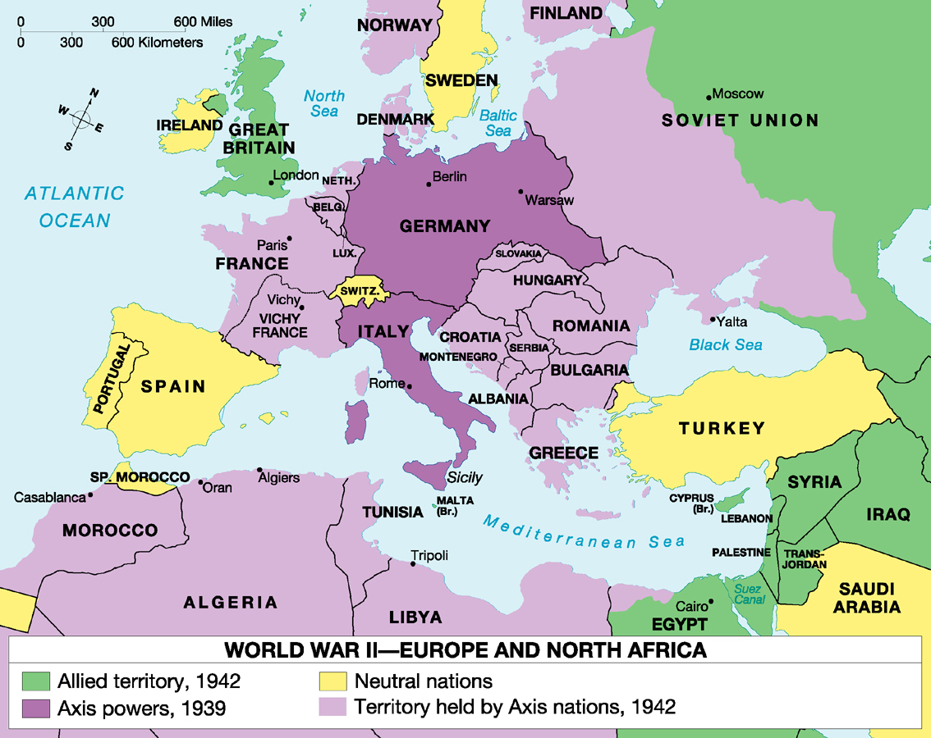
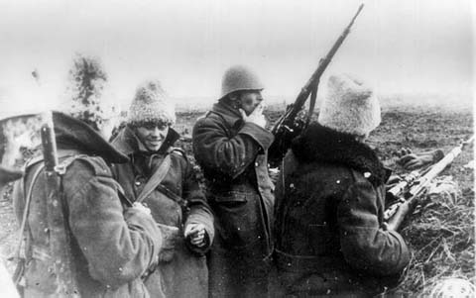
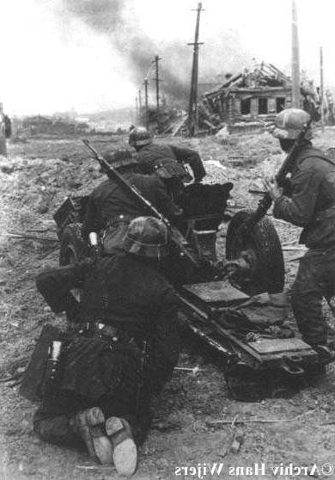
Battle of Stalingrad:
Winter of 1942-1943
German Army | Russian Army
1,011,500 men | 1,000,500 men
10,290 artillery guns | 13,541 artillery guns
675 tanks | 894 tanks
1,216 planes | 1,115 planes
Stalin orders his troops to the “scorched earth policy”
Germans are surrounded at Stalingrad and supply lines are cut by the Russians. Germans surrender to Soviets.

Slide 4
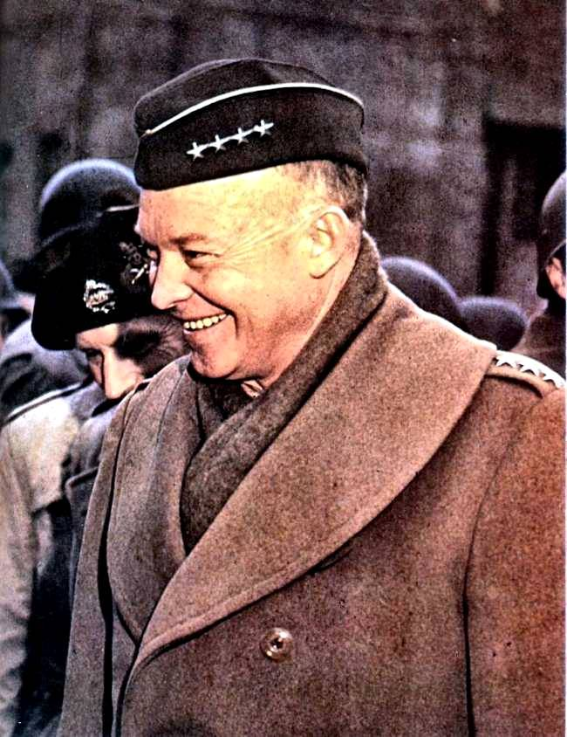
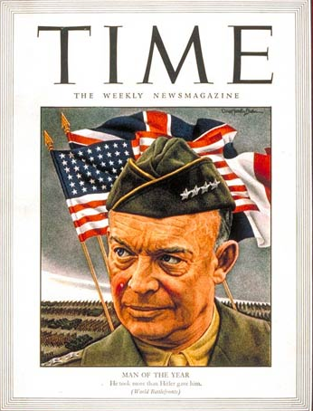
WWII American Military Leaders
4 Star, US General Dwight Eisenhower
Graduate of West Point
Commanded Allied invasion on North Africa in 1942
Named Supreme Allied Commander and in charge of D-Day.

Slide 5
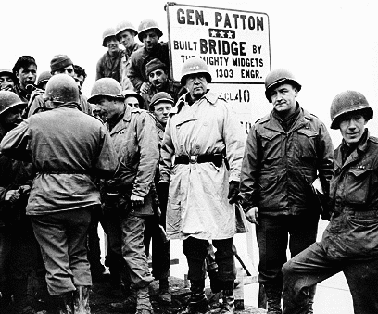
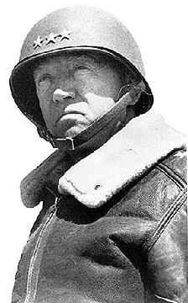
WWII American Military Leaders
General George Patton
Graduate of West Point
Tank commander and commander of the 7th Army
Germans feared Patton
“ole blood and guts”

Slide 6
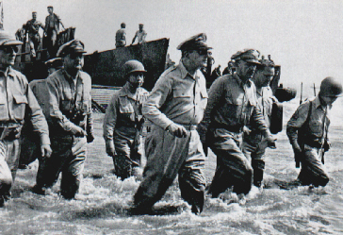
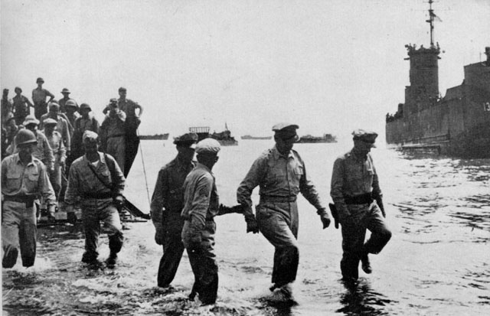
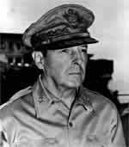
WWII American Military Leaders
General Douglas MacArthur
West Point Graduate
Commanding general of troops in the Philippines
Forced off the Philippines in 1942--- “I shall return”
1944, Battle of Leyete Gulf---- “I have returned to re-take the Philippines”.
Supreme Allied Commander in the South Pacific

Slide 7
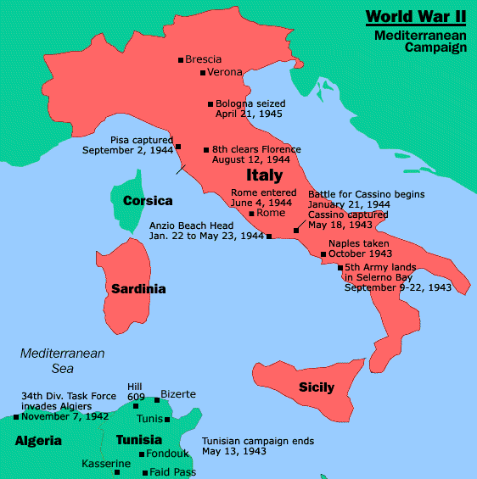
Italy
July 1943- British and American troops landed in Sicily
Sept. 3, 1943 Italy surrendered and ended the rule of Mussolini
Hitler made Mussolini leader of puppet state in N. Italy.
Fighting continued until 1945

Slide 8
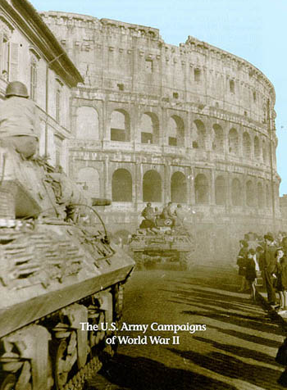
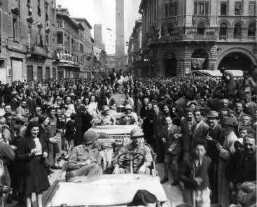
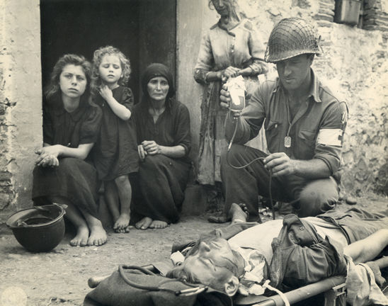
The Allies Liberate Rome:
June 5, 1944

Slide 9
Attack on Germany
Starting in 1942- British began dropping bombs on German cities. Saturation Bombing
Strategic bombing- trying to destroy industrial and political centers to avoid war making power.
Helped pave the way for an Allied offensive.

Slide 10
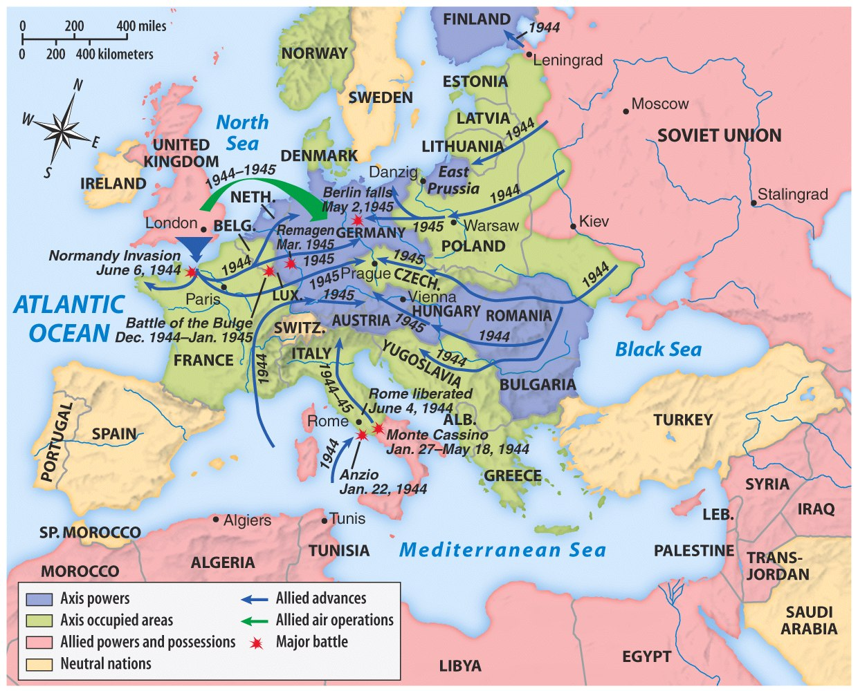
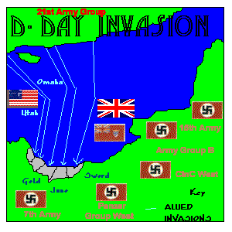

Slide 11
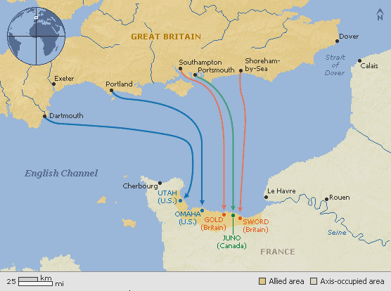
D-DAY INVASION
D-Day, the Decision Day
Largest military invasion in world history to defeat Hitler.
The 5000-vessel armada stretched as far as the eye could see, transporting over 150,000 men and nearly 30,000 vehicles across the channel to storm the French beaches.
Six parachute regiments -- over 13,000 men -- were flown from nine British airfields in over 800 planes.
More than 300 planes dropped 13,000 bombs over coastal Normandy immediately in advance of the invasion.
War planners had projected that 5,000 tons of gasoline would be needed daily for the first 20 days after the initial assault.
By nightfall on June 6, more than 9,000 Allied soldiers were dead or wounded, but more than 100,000 had made it ashore, securing French coastal villages.

Slide 12
D-DAY INVASION
To get through the barbed war, soldiers had to blast through with 10’ pipes filled with TNT.
Two portable harbors were built and transported across the English channel and setup on 1 of the British beaches and 1 with the Americans.
To get fuel from England to France, an underwater pipeline was laid which connected with the portable harbors to get fuel to the front..
To fool the Germans to believing the invasion was at Calais, the Allies dropped dummy parachute soldiers…..
June 6, 1944

Slide 13
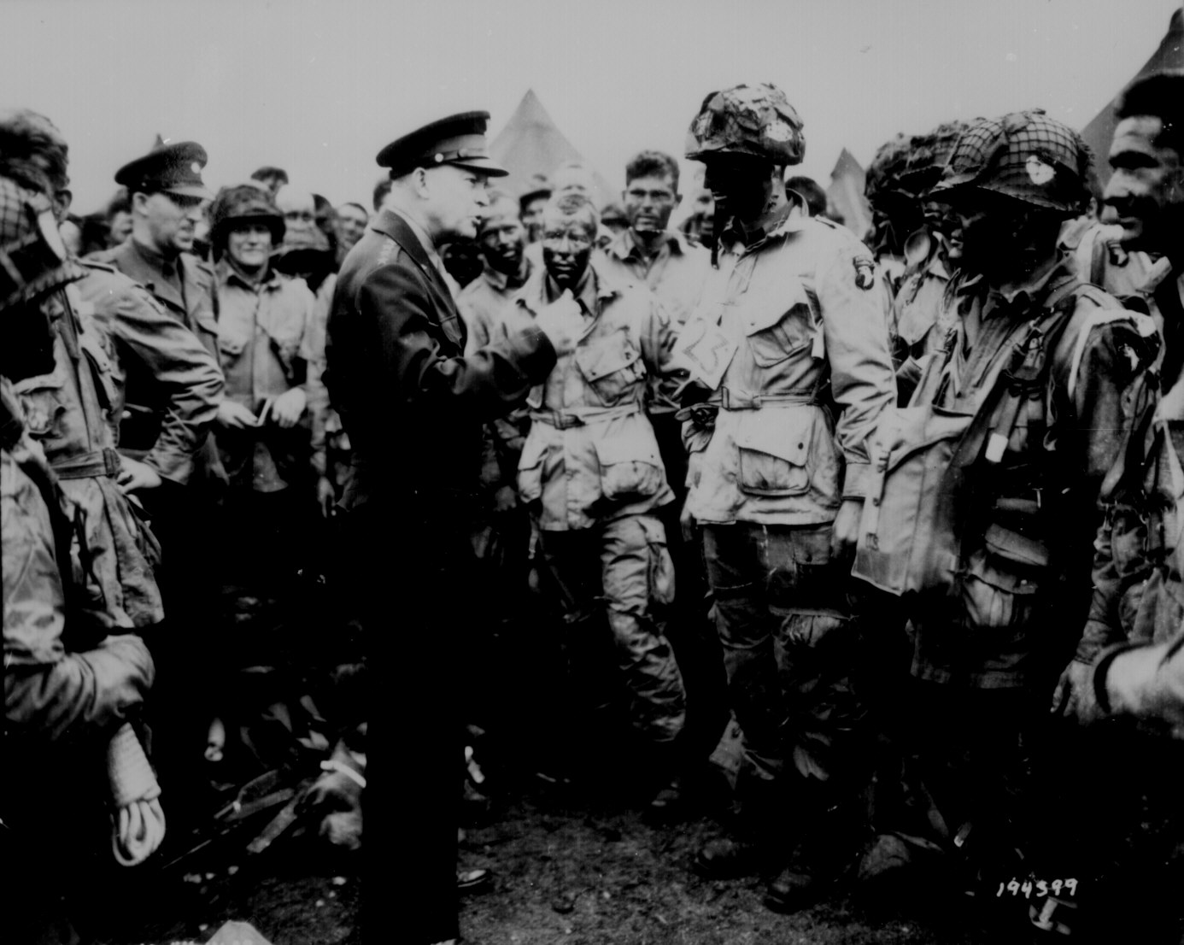
Gen. Eisenhower Gives the Orders for D-Day [“Operation Overlord”]
US General Dwight Eisenhower was chosen by the Big 3 at the Tehran Conference (Nov. 28-Dec. 1, 1943) as the Supreme Allied Commander and was responsible for the D-Day Invasion.

Slide 14
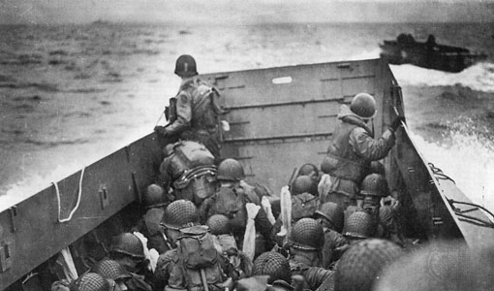

Slide 16
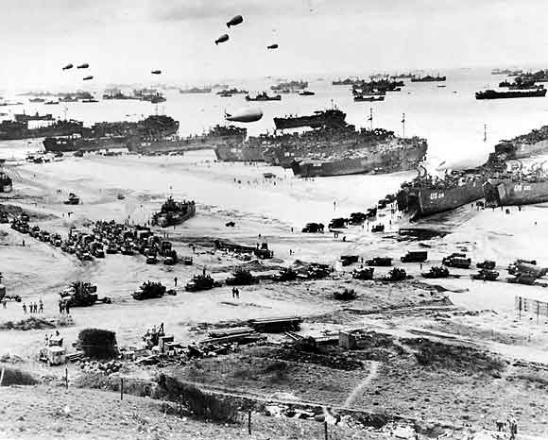

Slide 17
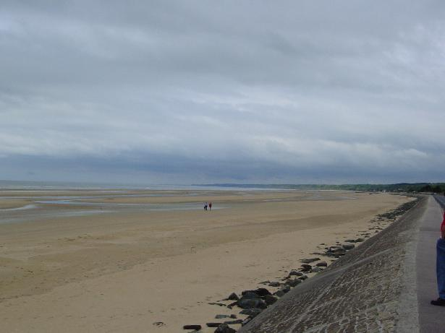
Normandy Beach Today

Slide 18
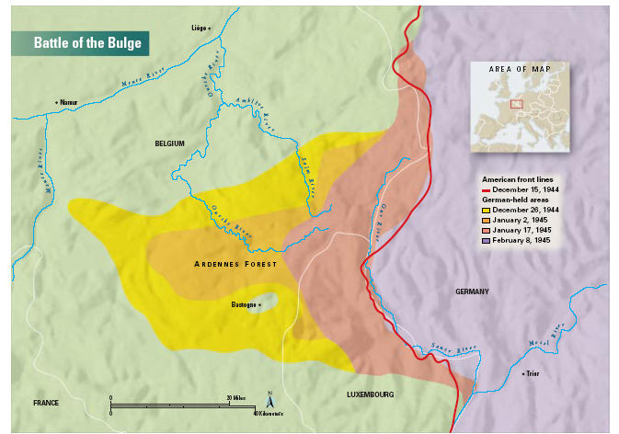
The Battle of the Bulge:
Hitler’s Last Offensive
Dec. 16, 1944 to Jan. 28, 1945

Slide 19
Battle of the Bulge
Hitler caught Allies by surprise and created a bulge in their front line and captured several key towns.
After about a month of fighting on December 23, 1944 the Allies pushed Germany out of France.
Battle hurt Hitler because he had to use reserve troops and it hurt his men. It shortened the time Germany had left.

Slide 20
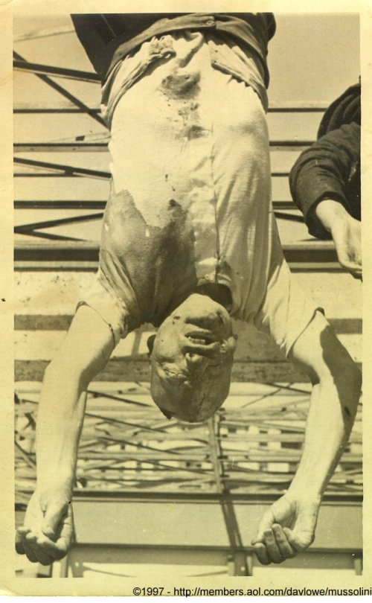
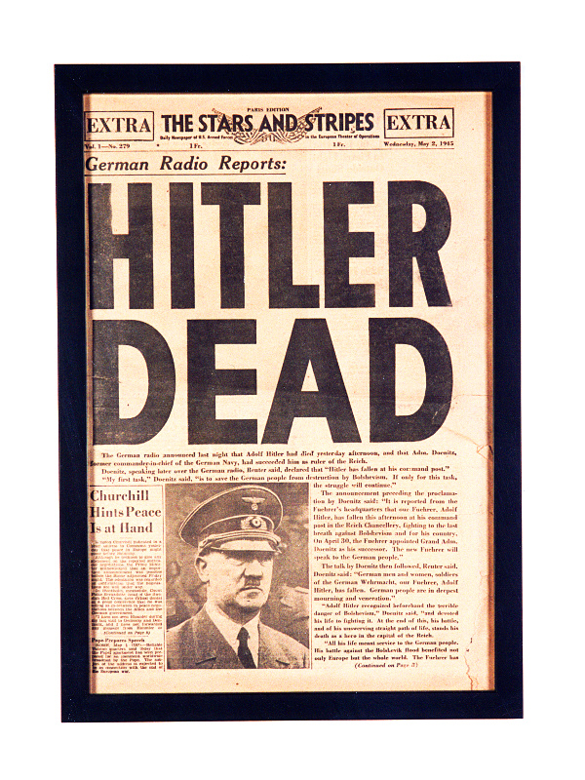
V-E Day
April 1945 Mussolini tried to flee to Switzerland and was caught and executed.
April 30, 1945 Hitler committed suicide along with several of his associates.
May 7, 1945 Germany surrendered. V-E Day
Harry S. Truman was President of the United States
(FDR died April 12, 1945).

